Slide 1

Multicore DLX with coherence protocol – Project Presentation
Project Name: Multicore DLX processor with MESI coherence protocol
Project Number: 3024
Project carried out at: University
Submitted by:
Yarin Koren
Yohai Shiloh
Project instructor approval signature:
Name: _Oren Ganon_

Slide 2
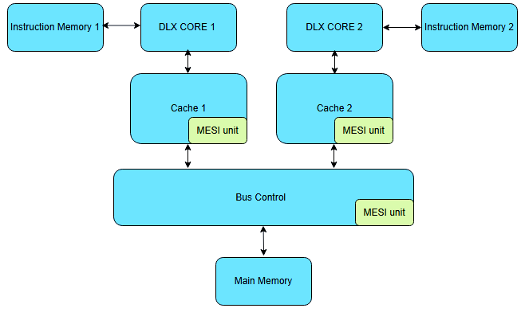
Multicore DLX with coherence protocol – Project Presentation
Introduction
Project general structure:

Slide 3

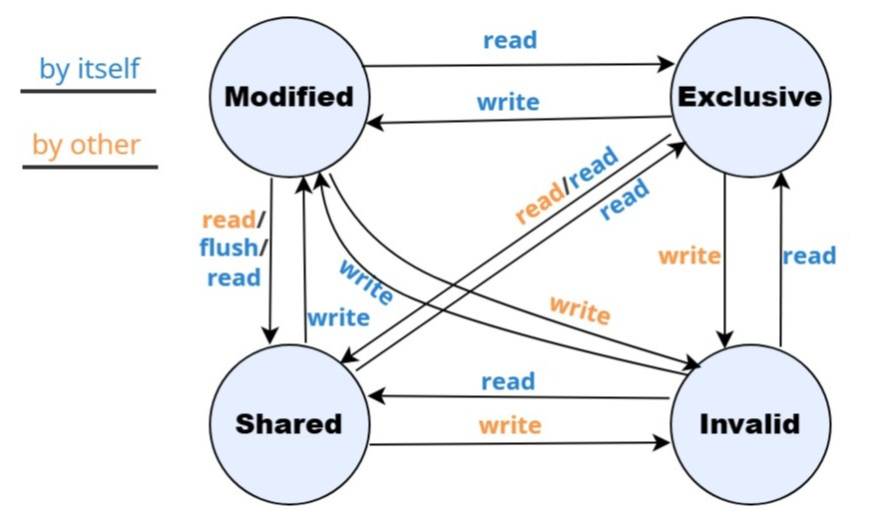
Multicore DLX with coherence protocol – Project Presentation
Motivation
Multicore:
Better performance – Achieving speedup and high performance by dividing programs across several cores. For example, splitting the input to perform computations on each part at the same time
Multitasking – Using parallelism to perform multiple tasks at the same time
Better usage of resources – Higher utilization of resources like the main memory, bus, I/O devices etc.
MESI coherence protocol:
Ensuring data coherence and synchronization in all caches in parallel by assigning validation state for each data block
The validation state saved inside the cache – always available immediately
Saves time by reducing data transmission with the main memory by performing “flush” between cores
speed
The MESI state machine

Slide 4
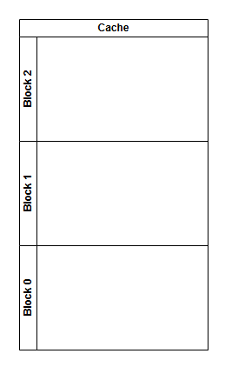
Multicore DLX with coherence protocol – Project Presentation
The MESI Protocol
While performing operations in parallel in multicore processor, data coherence must be kept to ensure the data used by each core is up-to-date, otherwise incorrect results might be received due to invalid inputs
The solution – using coherence protocol.
The MESI protocol work mechanism:
Each block assigned with certain state – Modified, Exclusive, Shared or Invalid
State transition will occur as result of read/write instruction by the cores
The cores snoop the bus and communicating each other to update the MESI states if needed
When modified block is being requested by another core, the core will “flush” the modified block directly, avoiding the latency of updating through the main memory
Cache structure illustration
The MESI states transitions diagram

Slide 5
Multicore DLX with coherence protocol – Project Presentation
Implementation
Workflow
Below is a general workflow of the cores, both work simultaneously while using MESI protocol. The bus control preserved correct access to the joint memory by the access queue, making sure each core receive the requested updated data (data routing) and handle signal transmitting.
Read or write
Valid
Read an instruction
Decode the instruction
LW/SW
Turn to cache control
Check for cache “hit” (if the block in cache)
Send transaction to Bus control
Update the MESI state
Read or write
Snooping the bus
arbitration
MESI is M
Flush
(optional)

Slide 6
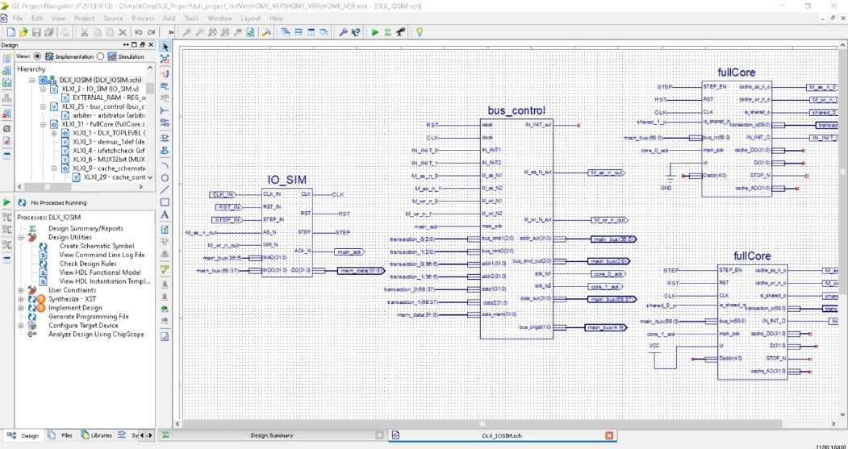
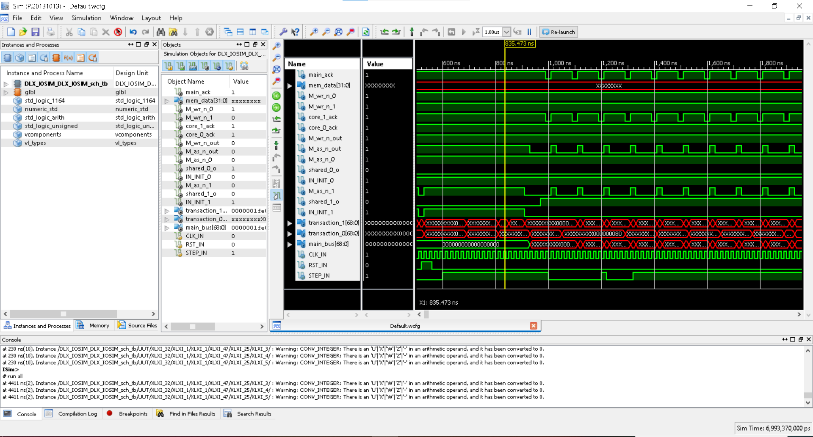
Multicore DLX with coherence protocol – Project Presentation
Implementation
Implementation guidelines and methods
All the blocks and hardware components were implemented using Verilog HDL or schematic drawing over Xilinx’s ISE software (shown in the upper picture on the left) and Microsoft’s VScode EDA (for Verilog only)
The programs wrote in Assembly language for DLX architecture, as it was defined in the ACSL course, and compiled to machine code using the RESA software
Testing scripts and testbenches were written in Verilog and simulated using Xilinx’s Isim (shown in the lower picture) platform
The Main Memory and additional components were provided to us by the staff of the ACSL course and used as black boxes
Also, we used basic components and logic gate, which were included in the ISE built-in library

Slide 7
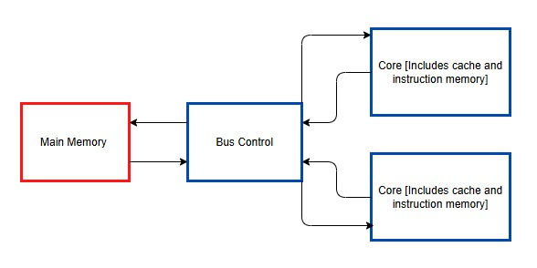
Multicore DLX with coherence protocol – Project Presentation
Implementation
Detailed architecture – top level
Main Memory – joint for both core
Bus control – performing arbitration, data routing and signal transaction handling
Core – includes a DLX simple processor, instruction memory unit and cache.
* Red blocks are black boxes – used for the project but wasn’t made by us. Blue blocks were made by us

Slide 8
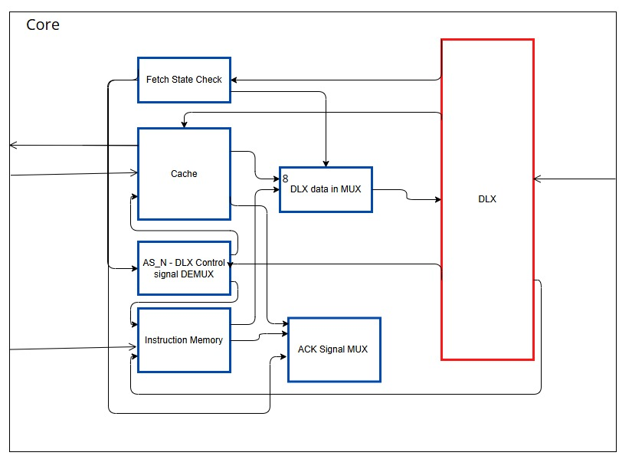
Multicore DLX with coherence protocol – Project Presentation
Implementation
Detailed architecture – processor core structure
DLX – simplified processor
Cache – fast access memory of limited local memory blocks. Includes MESI protocol
Instruction memory – separated memory unit for instruction only
Fetch State check – Indicates if DLX read instruction is in progress.
The DLX was implemented during the ASCL lab.

Slide 9
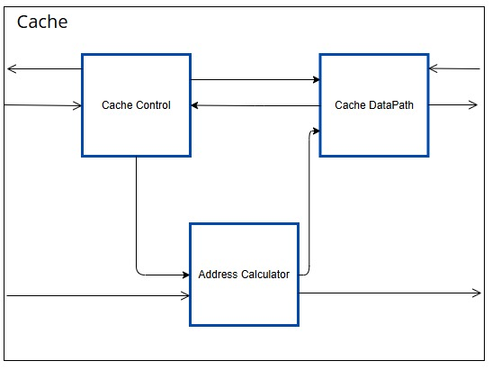
Multicore DLX with coherence protocol – Project Presentation
Implementation
Detailed architecture – cache internal structure
Cache control - managing the cache and Initiate memory transactions
Cache DATAPATH – Holds data and includes a bus snooping mechanism.
Address Calculator – calculates the requested address based on the various situations

Slide 10
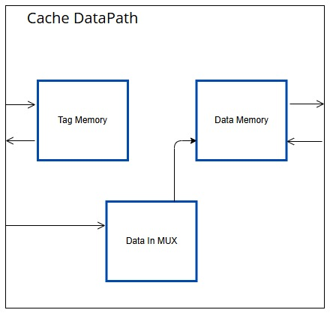
Multicore DLX with coherence protocol – Project Presentation
Implementation
Detailed architecture – the cache datapath
Tag memory - Contains overhead data like MESI states and bus snooper responsibilities
Data memory – Holds the data
Data in MUX – Selects the data source/destination – the DLX data or the Bus data

Slide 11
Multicore DLX with coherence protocol – Project Presentation
Validation
Verification coverage
To ensure the correctness of the designed multicore, several tests were conducted using targeted program to achieve full coverage. The tests’ results summarized in the next table:
Unit under test | Test/Tests | Tested by - | Notes
Instruction memory unit | Small input handling | Very short program
 | Very large input handling | Very long program
 | Parallel execution by multiple cores | Parallel programs
Cache unit | Data transmission from the main memory | Read/Write instructions on missing blocks ("cache miss") | On single-core DLX with cache extension
 | Data transmission to the core | Read/Write instructions on existing blocks ("cache hit") | On single-core DLX with cache extension
 | Updating data in the main memory | Read/Write instructions on missing blocks, while its place in the cache is occupied ("clearing "dirty" block") | On single-core DLX with cache extension
MESI Unit | Transition I to S, E, M | Read/Write instructions
 | Transition S to I | Read/Write was performed by another core
 | Transition S to E, M | Read/Write instructions
 | Transition E, M to I, S | Read/Write was performed by another core
 | Transition E, M to E, M | Read/Write instructions | Both by read/write to the same block and by calling to another block
Bus controller | Correct arbitration between the cores | Various combination of bus usage request from the cores in every possible order
 | Data transmission
 | Signal transmission | IN_INIT, ack_N, etc. from/to each MESI unit and main memory
 | Snooping | Read/Write instructions | This test is for both bus control and MESI units

Slide 12
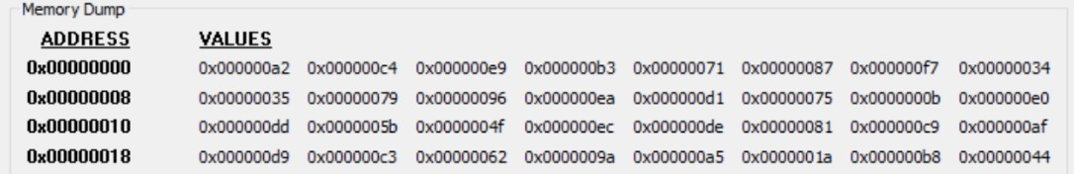
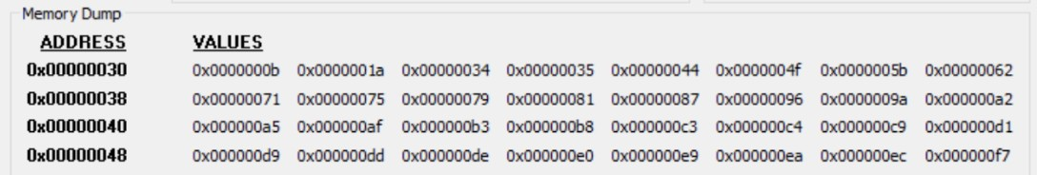
Multicore DLX with coherence protocol – Project Presentation
Validation
Correctness example
The design maintains correctness through parallelism thanks to the MESI protocol.
Example workload – bubble sort program:
The unsorted array - before the execution
The sorted array – after the execution
Performed on the FPGA via RESA software

Slide 13
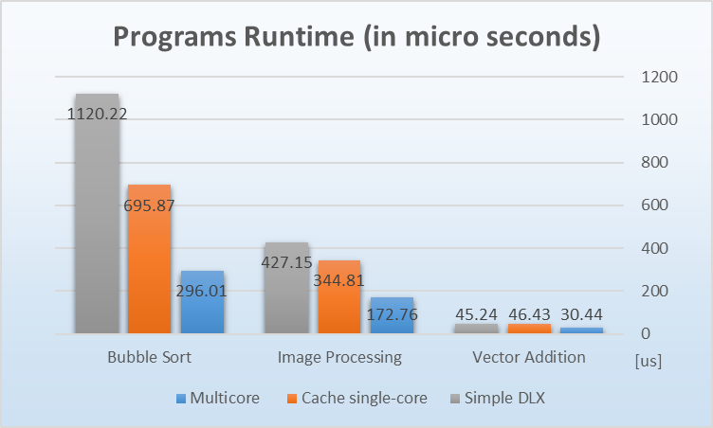
Multicore DLX with coherence protocol – Project Presentation
Results
Benchmark
To examine the design improvement, compared to the original DLX processor, a benchmark was made, testing various workloads. As a control tester, the programs performed by a cache single core processor, to verify the impact of parallelism in the results.
The benchmark contained three main programs:
Bubble sort program
Simple image processing task (segmentation)
Vector summing
The runtime of those programs is summarized in the graph on the left, showing major improvement by the multicore compared to both cached single core processor and the original DLX, demonstrating the significancy of the parallelism in the speedup the system achieved

Slide 14
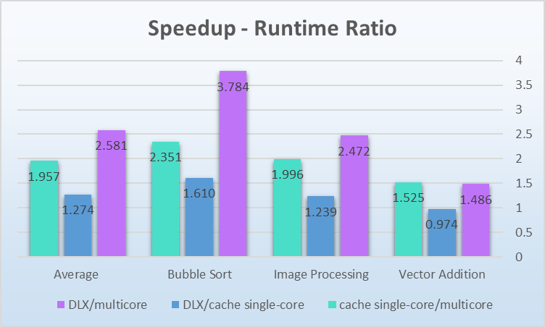
Multicore DLX with coherence protocol – Project Presentation
Results
Performance analysis:
The benchmark shows significant improvement, up to x3.78 in runtime by the multicore processor.
The mild improvement of the cached single core shows that while other improvements (caches, instruction memory) also contributed, the parallelism was the most significant factor in the superiority of the system
Averaging speedup of x2.58, the multicore design undoubtedly achieved the original goal of the project in performance improvement

Slide 15
Multicore DLX with coherence protocol – Project Presentation
Further work
Multiprocessor
Improvements in multicore level:
Higher level of parallelism – more than two cores in the system
Exploring the advantages of more advanced protocols, such as “Dragon" protocol
Integrate MOESI for reduced memory traffic.
Scale, Coordination and synchronization
Single processor
Improvements in single-core level:
Pipelining processors for higher throughput
Out-of-order execution to reduce stalls
Branch prediction to reduce loss of pipelined execution through branch instructions
ILP – instruction level parallelism

Slide 16
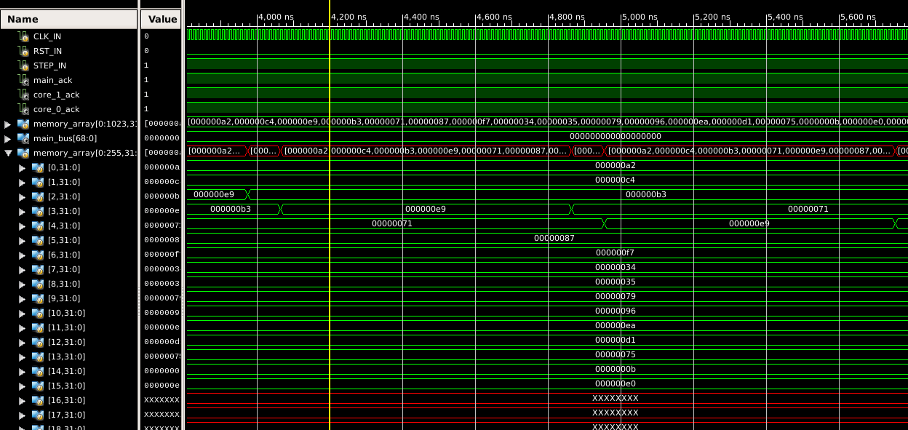
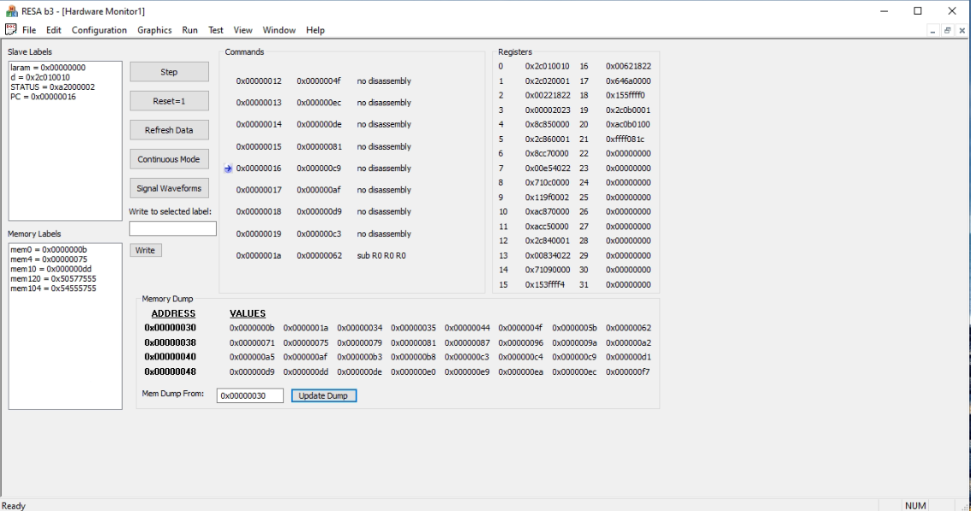
Multicore DLX with coherence protocol – Project Presentation
Demonstration
Bubble sort live execution
In simulation
on the FPGA board
Isim and RESA (illustration)

Slide 17
Multicore DLX with coherence protocol – Project Presentation
Documentation
GitHub

